Slide 1


PROJECT PRESENTATION
LIBRARY STUDIO
Library Management System
A web-based solution for organized library operations
Submitted by: Esita Hatua
Student Code: BWU/MCA/26/015
Sec: A Group: 1
Department: Computational Sciences
Course Name: Problem Solving Using Python
Course Code: MCA17401
Dept. of Computational
Sciences

Slide 2
LIBRARY STUDIO
Introduction
Library Management System
PROJECT OVERVIEW
• Libraries maintain book, member and circulation information.
• Manual registers or spreadsheets take time and make tracking harder.
• Searching availability and calculating overdue fines can be error-prone.
• Library Studio centralizes these activities in one web interface.
A simple, modular application to manage the everyday lifecycle of library resources.
Books
Members
Circulation
Goal: reduce manual effort and improve record organization.
2

Slide 3
LIBRARY STUDIO
Problem statement
Manual library administration can become slow, fragmented and difficult to monitor.
Time-consuming
Hard to track
Records need repeated manual entry and checking.
Book availability and active issues are not always easy to identify.
Calculation risk
Limited visibility
Manual overdue-fine calculations may contain errors.
Preparing totals and library statistics requires extra work.
Project need: a centralized system that supports reliable day-to-day library operations.
3

Slide 4
LIBRARY STUDIO
Project objectives
Organize records
Simplify circulation
Apply fine rules
Maintain book catalogue and member information.
Issue available books and process returns.
Calculate overdue charges at ₹5 per day after 14 days.
Protect records
Improve visibility
Validate inputs
Restrict deletion of books or members involved in active issues.
Show totals for books, availability, issues and members.
Reduce incorrect data entry and provide user feedback.
4

Slide 5
LIBRARY STUDIO
Scope of the project
Included
Target users
Current boundaries
• Book catalogue management
• Member registration
• Book issue and return
• 14-day borrowing period
• ₹5/day overdue fine
• Dashboard and charts
• Input validation
Primarily a librarian or library operator managing routine library records and circulation through a browser.
• Single-operator focus
• JSON file storage
• Basic dashboard reporting
• No advanced role-based security
• Fixed loan and fine rules
The project demonstrates essential library workflows; it is not presented as an enterprise-scale platform.
5

Slide 6
LIBRARY STUDIO
Literature review / existing system
Existing approaches described in the report
Manual registers
Spreadsheets
Book details, member information and issue/return records are maintained by hand. This requires repeated checking and manual calculations.
Digital tables can organize records, but circulation tracking, validation and automated fine handling may still need manual effort.
Identified limitations
• Time-consuming record maintenance • Difficulty searching and tracking availability
• Potential fine-calculation errors • Extra work to prepare library statistics
6

Slide 7
LIBRARY STUDIO
Proposed system & key features
Book management
Member management
Add, view and manage catalogue records.
Register members and maintain member information.
Issue / return
Fine calculation
Issue available books; update availability on return.
₹5 per overdue day after the 14-day loan period.
Deletion controls
Dashboard
Prevent deletion of issued books or members with active issues.
Display totals and charts for library status.
7

Slide 8
LIBRARY STUDIO
Project methodology & technology stack
1
2
3
4
5
6
Initiation
Requirements
System design
Development
Testing
Documentation
Technology stack
Backend
Python + Flask
Frontend
HTML + CSS + JavaScript
Storage
JSON file: library_data.json
Charts
Chart.js
Template engine
Jinja
Browser
Google Chrome or equivalent
Development approach: structured phases with modular implementation and functional verification.
8

Slide 9
LIBRARY STUDIO
Project internal structure: system architecture
PRESENTATION LAYER
HTML • CSS • JavaScript
APPLICATION LAYER
Python • Flask routes • validation • library logic
DATA STORAGE LAYER
library_data.json • books • members • issue / return records
VISUALIZATION • Chart.js dashboard
Request flow: browser → Flask processing → JSON read/write → response and updated view.
9

Slide 10
LIBRARY STUDIO
Implementation detail: fine calculation
Examples from the report
BUSINESS RULE
14-day loan period
₹5 per late day
0 days
₹0
1 day
₹5
3 days
₹15
Fine = Late Days × ₹5
5 days
₹25
Example: 3 late days × ₹5 = ₹15
10

Slide 11
LIBRARY STUDIO
Testing & results
Functional test coverage described in the project report
Add valid book
Record should be saved
Invalid book details
Validation error should appear
Register member
Member record should be saved
Delete member with active issue
Deletion should be prevented
Issue available / unavailable book
Success / reject operation
Return issued book
Availability should update
Return after 14 days
Fine should be calculated
Issue or return a book
Dashboard statistics should update
Reporting note: the source lists expected outcomes and test scenarios; it does not provide measured response times or a complete pass/fail log.
11

Slide 12
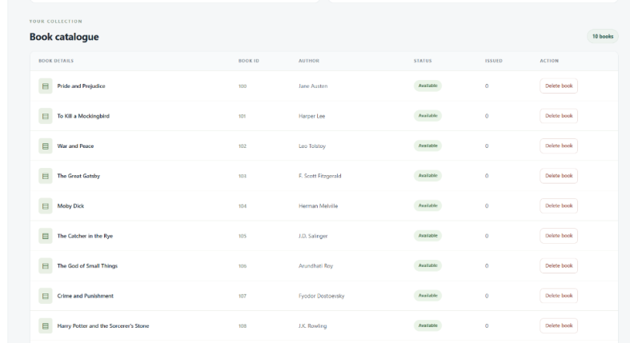
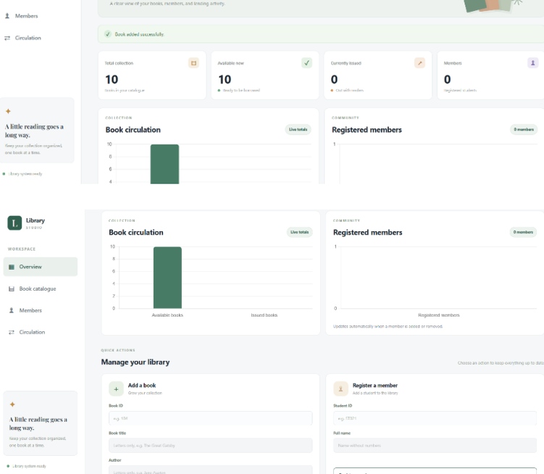
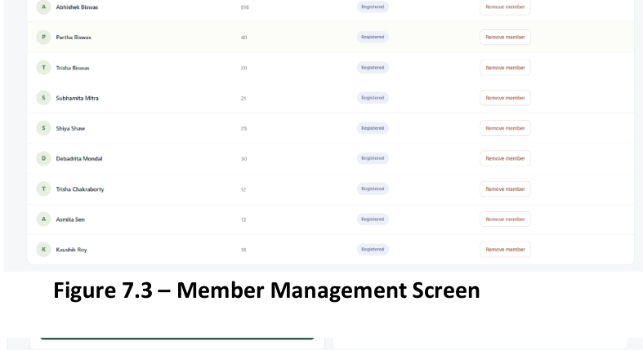
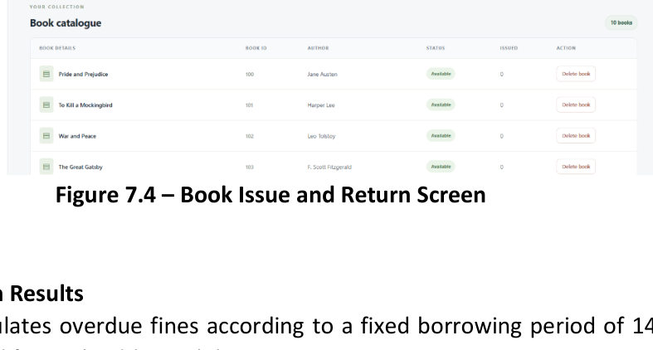
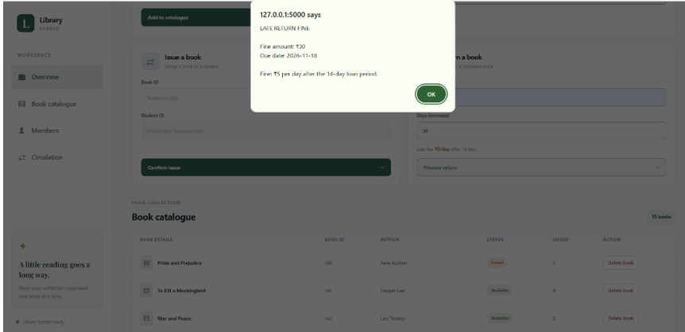
LIBRARY STUDIO
Output screenshots
Book catalogue
Library dashboard — Figure 7.1
Member management
Book issue & return
Fine notification popup — Figure 7.5
Screenshots reproduced from the supplied project report (Chapter 7, Figures 7.1–7.5).
12

Slide 13
LIBRARY STUDIO
Future scope
Database integration
Authentication
Notifications
Adopt MySQL or SQLite.
Add login and access levels.
Email/SMS reminders for due dates and overdue books.
Advanced reporting
Reservations
Cloud deployment
Detailed circulation, membership and fine reports.
Allow members to reserve books online.
Enable remote access through hosting.
13

Slide 14
LIBRARY STUDIO
Conclusion
Library Studio demonstrates how a web application can organize essential library operations in one place.
Objectives addressed
Learning outcomes
• Book and member record management
• Issue, return and overdue-fine workflow
• Dashboard statistics and input validation
• Python and Flask web development
• HTML, CSS, JavaScript and JSON data handling
• System design, modular development and testing
14

Slide 15
LIBRARY STUDIO
References
Python Documentation
https://docs.python.org/3/
Flask Documentation
https://flask.palletsprojects.com/
Jinja Documentation
https://jinja.palletsprojects.com/
MDN — HTML
https://developer.mozilla.org/en-US/docs/Web/HTML
MDN — CSS
https://developer.mozilla.org/en-US/docs/Web/CSS
MDN — JavaScript
https://developer.mozilla.org/en-US/docs/Web/JavaScript
Chart.js Documentation
https://www.chartjs.org/docs/latest/
Python JSON documentation
https://docs.python.org/3/library/json.html
Library Studio source files
app.py, library_data.json, templates/index.html, static/style.css
Source report: Library Studio: Library Management System — Date of access stated as 03 November 2026.
15

Slide 16
THANK YOU!
Dept. of Computational
Sciences

